Slide 1
Basic Snake Game
Pygame Project
Roudra Mondal (CST-3B)

Slide 2
Table of content
Introduction
Features
Technologies Used
Key Functions
Demonstrations
Future Enhancements
Conclusion

Slide 3
Introduction
The Snake Game is a classic arcade game where the player controls a snake to eat food and grow while avoiding self-collision.
Developed using Python and Pygame, this project demonstrates fundamental game development concepts.
Features include a dynamic speed system, wrap-around movement, and pause/resume functionality.

Slide 4
Features
Smooth Movement: Grid-based movement with directional controls.
Food Collection: The snake eats food to grow, increasing the score.
Speed Control: Players can adjust speed, and it increases with score.
Pause & Restart: Players can pause/resume the game or restart after losing.
Wrap-Around Feature: The snake reappears on the opposite side of the screen when hitting the edges.
Visual Enhancements: Includes a grid background and rounded snake segments for better aesthetics.

Slide 5
Technologies Used
Python (Main programming language)
Pygame (For game development and rendering)
Random Module (For generating food positions)
Event Handling (To capture player input and update the game state)

Slide 6
Key Functions
update_title() – Updates the window title with the score and speed.
reset_game() – Resets the game state for a new session.
draw_grid() – Draws a grid background for better visuals.
wrap_around() – Implements wrap-around movement when the snake hits screen edges.
Game Loop – Handles player input, movement, collisions, and rendering.

Slide 7
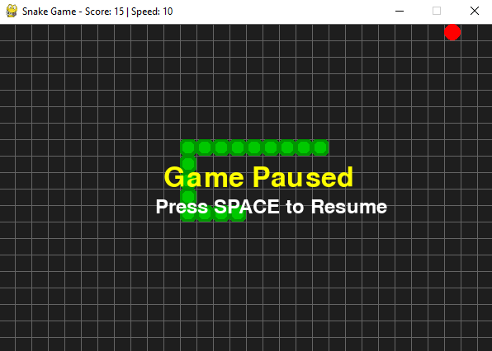
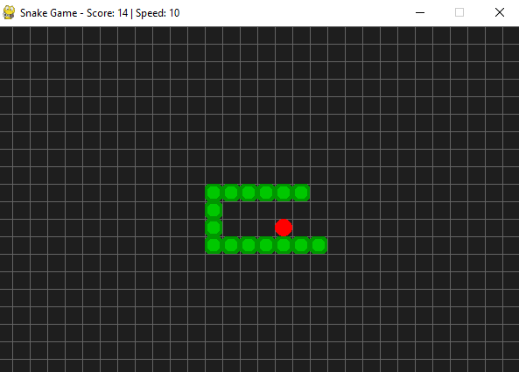
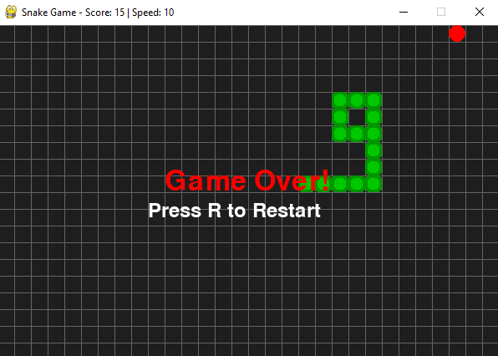
Demonstration
Pause Screen
Running Screen
Game over Screen
Screenshots of the Snake Game

Slide 8
Future Enhancements
Obstacles & Levels: Introduce walls and progressive difficulty.
High Score Tracking: Save and display best scores.

Slide 9
Conclusion
The Snake Game project showcases essential game development skills in Python.
It includes engaging gameplay mechanics and a user-friendly interface.
Future improvements will enhance the gaming experience further.

Slide 10
Any Question ?

Slide 11
Thank you

